Slide 1
Testing Process and Methods
CS 441, Spring 2020, Yongjie Zheng

Slide 2
Context of Software Testing
Verification & Validation
  Verification: checking that the software conforms to its specification.
  Validation: checking that the software meets the customer’s expectations. – more general
  Verification and validation are different and independent.
    E.g., There may be the case where verification succeeds, but validation fails.
  Validation exposes flaws in specifications.
CS 441 Software Engineering

Slide 3
Context of Software Testing
Techniques of verification and validation
  Inspections – static
    Code review
    Automated code analysis
    Formal verification
  Software testing - dynamic
CS 441 Software Engineering

Slide 4
Definition of Software Testing
Software testing is a fundamental technique used to determine errors. It executes the software using representative data samples and comparing the actual results with the expected results.
CS 441 Software Engineering

Slide 5
Software Test: Pass/Fail
Given a software system S and a test case t:
  Test case t passes if the actual output for an execution of S with t is the same as the expected output for t; otherwise t fails.
CS 441 Software Engineering

Slide 6
How to generate test cases
White-box testing – structural, program-based testing
  Test cases are designed, selected, and run based on structure of the source code (control-flow coverage, data-flow coverage).
  Tests the nitty-gritty.
  Drawbacks: need access to source.
Black-box testing – functional, specification-based testing
  Test cases are designed, selected, and run based on specifications.
  Tests the overall system behavior.
  Drawbacks: less systematic.
CS 441 Software Engineering

Slide 7
What to test
Unit test
  Testing individual modules.
Integration test
  Testing the composition of modules.
System (acceptance) test
  Testing the whole system against requirements specification.
Regression test
  Retesting a modified program.
CS 441 Software Engineering

Slide 8
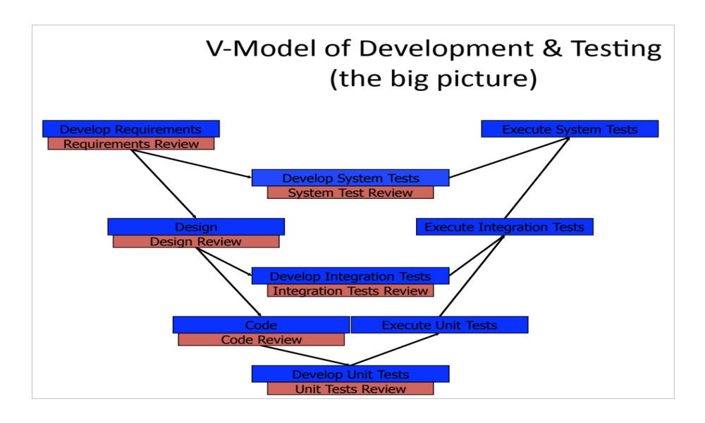
V-Model
CS 441 Software Engineering

Slide 9
Let’s get them summarized a little bit …
 | Unit Test | Integration Test | System Test | Regression Test
White-box test | ★ | ★ |  | ★
Black-box test |  | ★ | ★ | ★
CS 441 Software Engineering

Slide 10
Important Activities in Software Testing
Test Data (Test Case) Generation
  Input
    White-box: structure coverage.
    Black-box: specification based.
  Expected Output
    Test Oracle: the tester or an external mechanism that can accurately decide whether or not the output produced by a program is correct.
    Non-testable.
      No oracle: for example, to test a program that calculates the total volume of water on earth.
      Have oracle, but hard to decide: for example, to test a program that sorts an integer array whose size is over 1,000.
Localizing fault based on test results
CS 441 Software Engineering

Slide 11
Testing Techniques
Test Data Generation
  Ostrand, T. J. and Balcer, M. J. 1988. The category-partition method for specifying and generating functional tests. Commun. ACM 31, 6 (Jun. 1988), 676-686.
Fault Localization
  Jones, J. A., Harrold, M. J., and Stasko, J. 2002. Visualization of test information to assist fault localization. In Proceedings of the 24th international Conference on Software Engineering (Orlando, Florida, May 19 - 25, 2002). ICSE '02. ACM, New York, NY, 467-477.
CS 441 Software Engineering

Slide 12
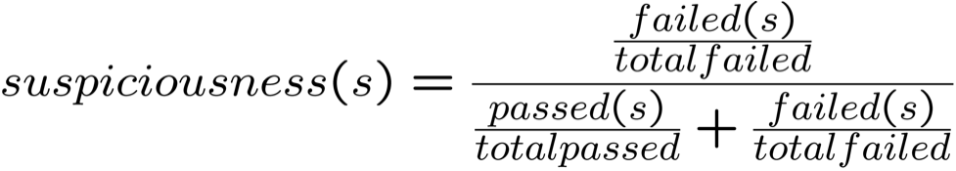
Fault Localization Using Visualization Technique
Intuition
  Statements that are primarily executed by failed test cases are more suspicious than statements that are primarily executed by passed test cases.
CS 441 Software Engineering

Slide 13
Fault Localization Using Visualization Technique
Input (S: a software system; t: test case; T: test suite)
  The source code for S
  The pass/fail results for executing S with each t in T
  The code coverage of executing S with each t in T
    The code coverage for t consists of the source code statements that are executed when S is run with t.
Output
  Suspicious score for each executed source code statement
  Visualization of the source code in which the individual statements are colored according to their participation in the testing
CS 441 Software Engineering

Slide 14

Fault Localization Using Visualization Technique
The following five slides are provided by Prof. James A. Jones.
CS 441 Software Engineering

Slide 15
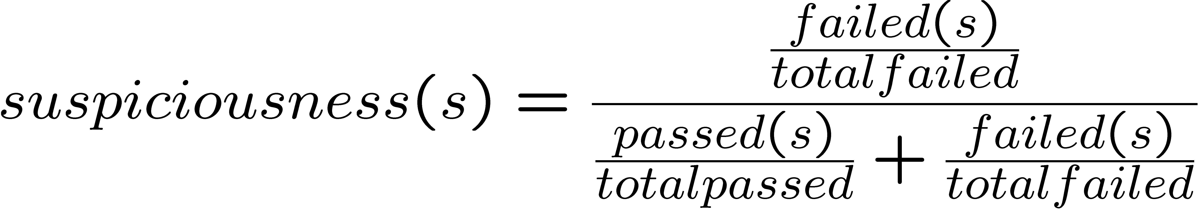
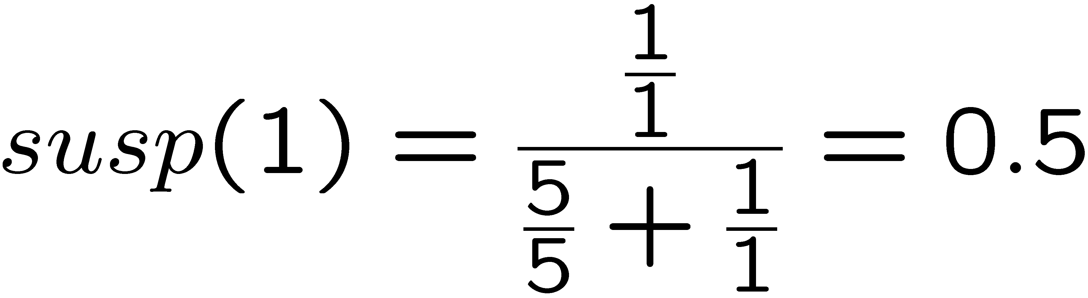
suspiciousness
mid() {
int x,y,z,m;
1: read(“Enter 3 numbers:”,x,y,z);
2: m = z;
3: if (y<z)
4: if (x<y)
5: m = y;
6: else if (x<z)
7: m = y; // bug
8: else
9: if (x>y)
10: m = y;
11: else if (x>z)
12: m = x;
13: print(“Middle number is:”, m);
}
3,3,5
1,2,3
3,2,1
5,5,5
5,3,4
2,1,3
•
•
•
•
•
•
•
•
•
•
•
•
•
•
•
•
•
•
•
•
•
•
•
•
•
•
•
•
•
•
•
•
•
•
•
•
•
•
•
•
0.5
0.5
0.6
0.0
0.7
0.0
0.0
0.0
0.0
0.0
0.5
0.5
0.8
Pass Status
P
P
P
P
P
F
CS 441 Software Engineering

Slide 16
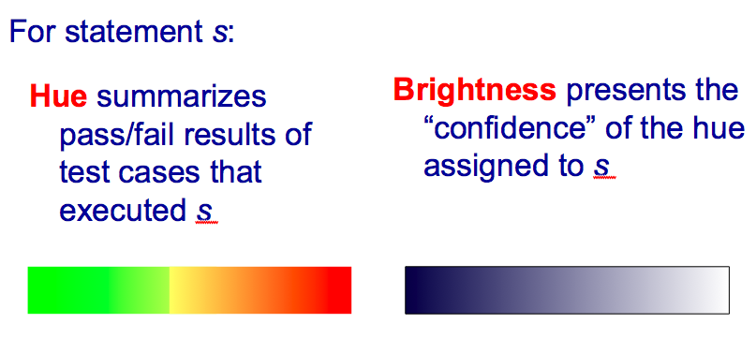
Fault Localization Using Visualization Technique
CS 441 Software Engineering

Slide 17
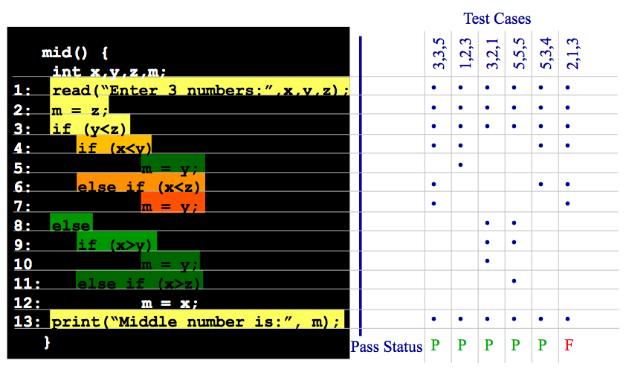
Fault Localization Using Visualization Technique
CS 441 Software Engineering

Slide 18
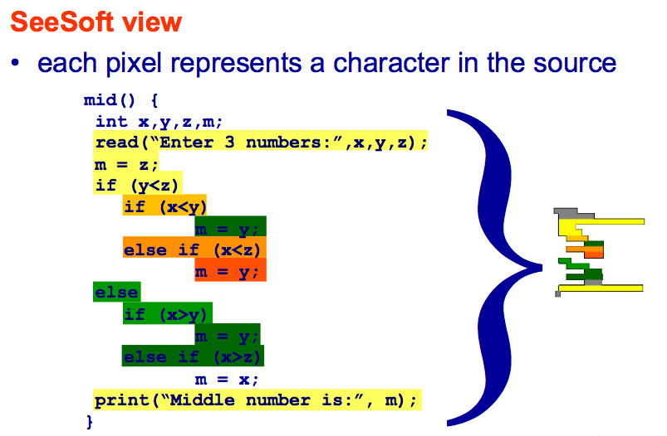
Fault Localization Using Visualization Technique
CS 441 Software Engineering

Slide 19
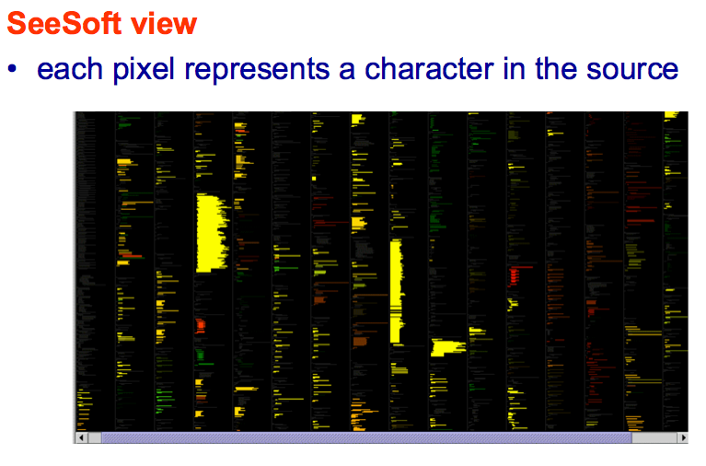
Fault Localization Using Visualization Technique
CS 441 Software Engineering

Slide 20
Category-Partition Method for Generating Functional Tests
Goal
  The tests are executed for all of the systems’ functions
  The tests are designed to maximize the chances of finding errors in the software.
    Testing boundary conditions, special cases, error handlers, and cases where inputs and the system environment interact in potentially dangerous ways.
Approach
  Partition the input domain of a function being tested, and then select test data from each class of the partition.
  The idea is: all elements within an equivalence class are essentially the same for the purpose of testing.
CS 441 Software Engineering

Slide 21
Category-Partition Method for Generating Functional Tests
Specific Steps of Category-Partition Method
  Decompose functional specification into functional units that can be tested independently.
  Identifying categories based on parameters and environment conditions.
    Parameters are the explicit inputs to a functional unit
    Environment conditions are characteristics of the system’s state at the time of executing a functional unit
    A category is a major property or characteristic of a parameter or environment condition.
  Partition each category into distinct choices.
  Determine constraints among the choices.
  Generate testing specifications.
CS 441 Software Engineering

Slide 22
Category-Partition Method for Generating Functional Tests
Rule of Thumb
  Choose test cases on the boundaries of the partitions plus cases close to the mid-point of the partition.
  While the categories are derived entirely from information in the specification, the choices can be based on
    The specification
    The tester’s past experience
    Knowledge about the system
CS 441 Software Engineering

Slide 23
Category-Partition Method for Generating Functional Tests
Example: Search
procedure Search (Key : ELEM ; T: ELEM_ARRAY;
Found : out BOOLEAN; L: out ELEM_INDEX) ;
Pre-condition
The array has at least one element
T’FIRST <= T’LAST
Post-condition
The element is found and is referenced by L
( Found and T (L) = Key)
or
The element is not in the array
( not Found and
not (exists i, T’FIRST >= i <= T’LAST, T (i) = Key ))
CS 441 Software Engineering

Slide 24
Category-Partition Method for Generating Functional Tests
Category Partitions for Search
  Number of occurrences of key in the sequence
    none, exactly one (assuming no duplicates in the sequence)
  Position of key in the sequence
    first element, middle element, last element
  Sequence size
    single value, many values
CS 441 Software Engineering

Slide 25
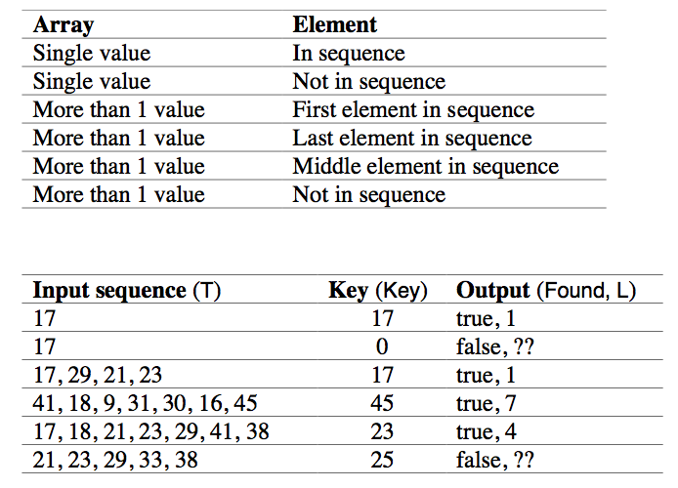
Category-Partition Method for Generating Functional Tests
CS 441 Software Engineering

Slide 26
Facts About Testing
Testing can only show the presence of errors, not their absence.
Automatic test cases generation is impossible.
A major problem that arises during integration testing is localizing errors.
CS 441 Software Engineering

